Slide 1
TVM
An Automated End-to-End Optimizing Compiler for Deep Learning

Slide 2
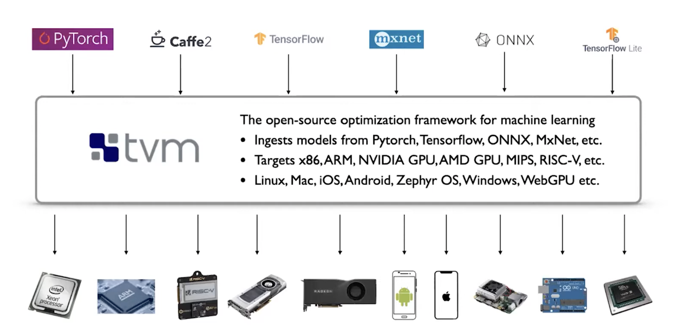
TVM

Slide 3
TVM
Portability
When there are limited hardware options to deploy your model (ex: non x86 ISAs; unsupported GPU,DSP, Accelerators...; not a mainstream OS)
Efficiency
When you need to squeeze as much efficiency out of your target platform (most frameworks rely on libraries that are optimized for the common workload.)
Software support
When you need to build a software stack for your hardware system (build the complete compiler stack is very challenging)

Slide 4
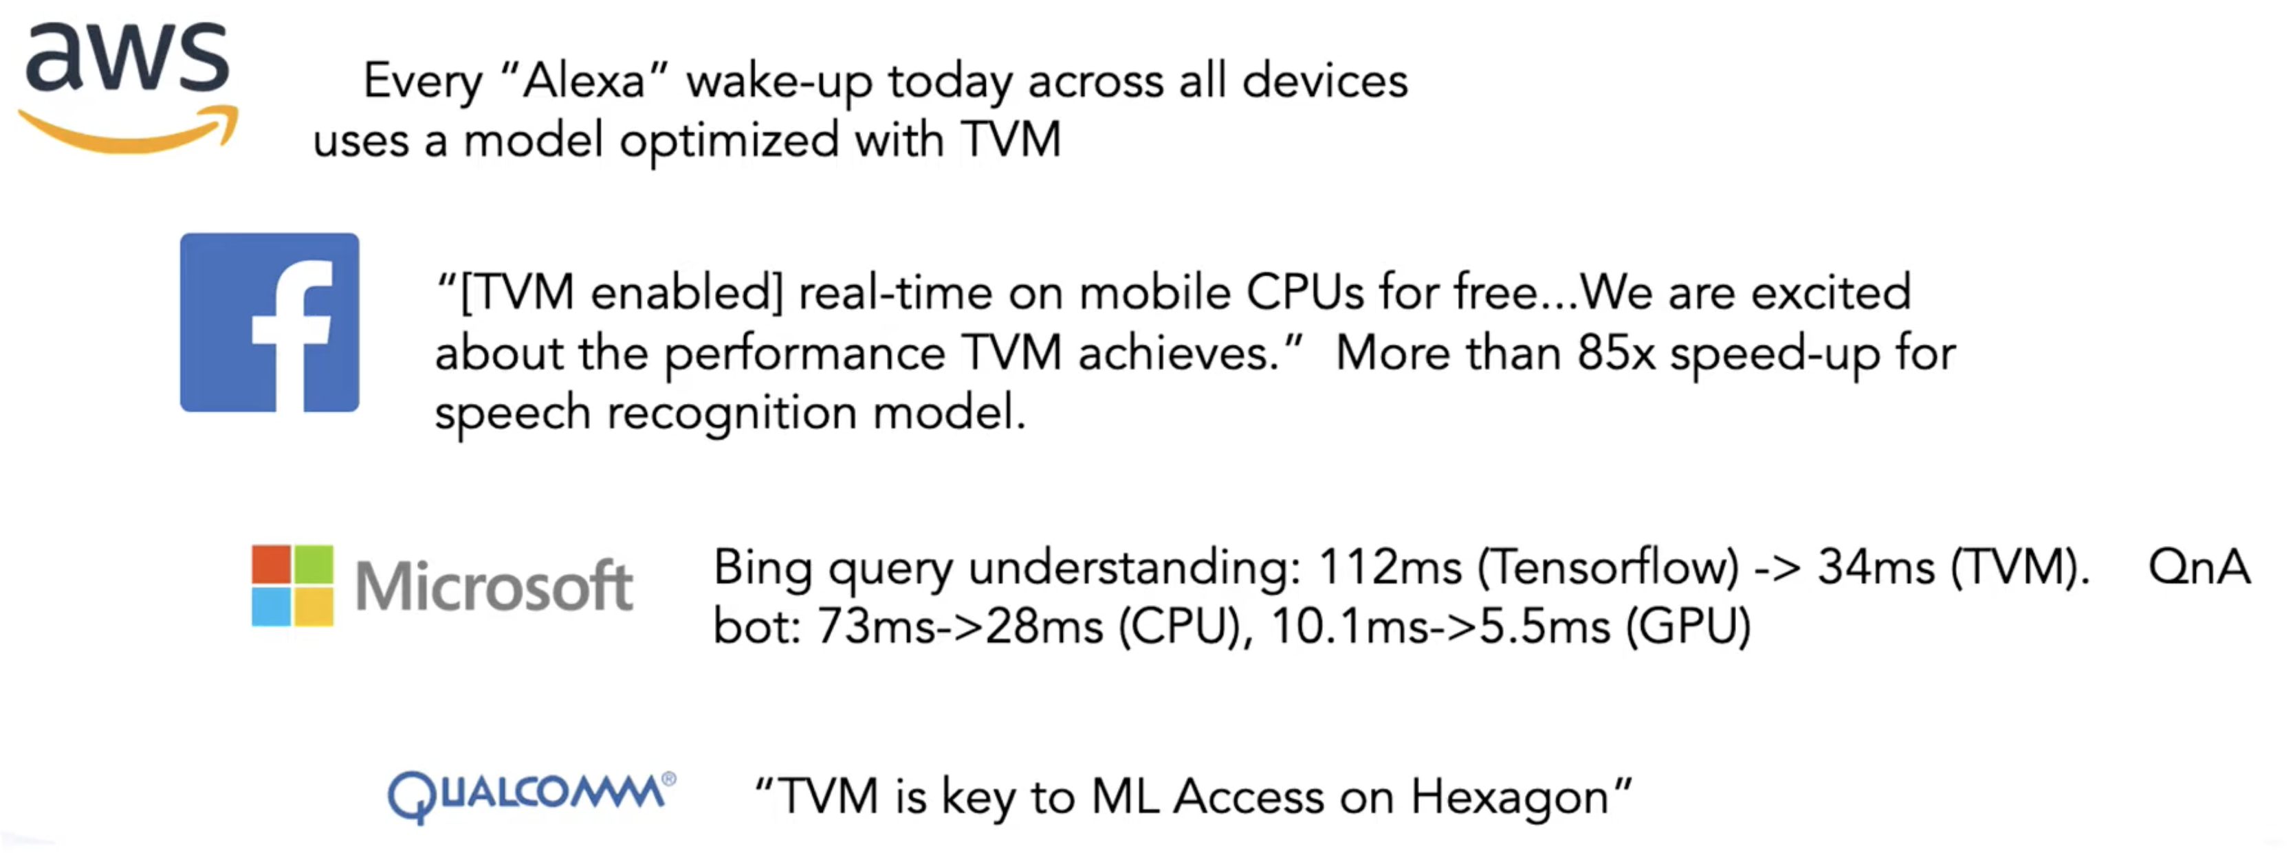
TVM impact on industry

Slide 5
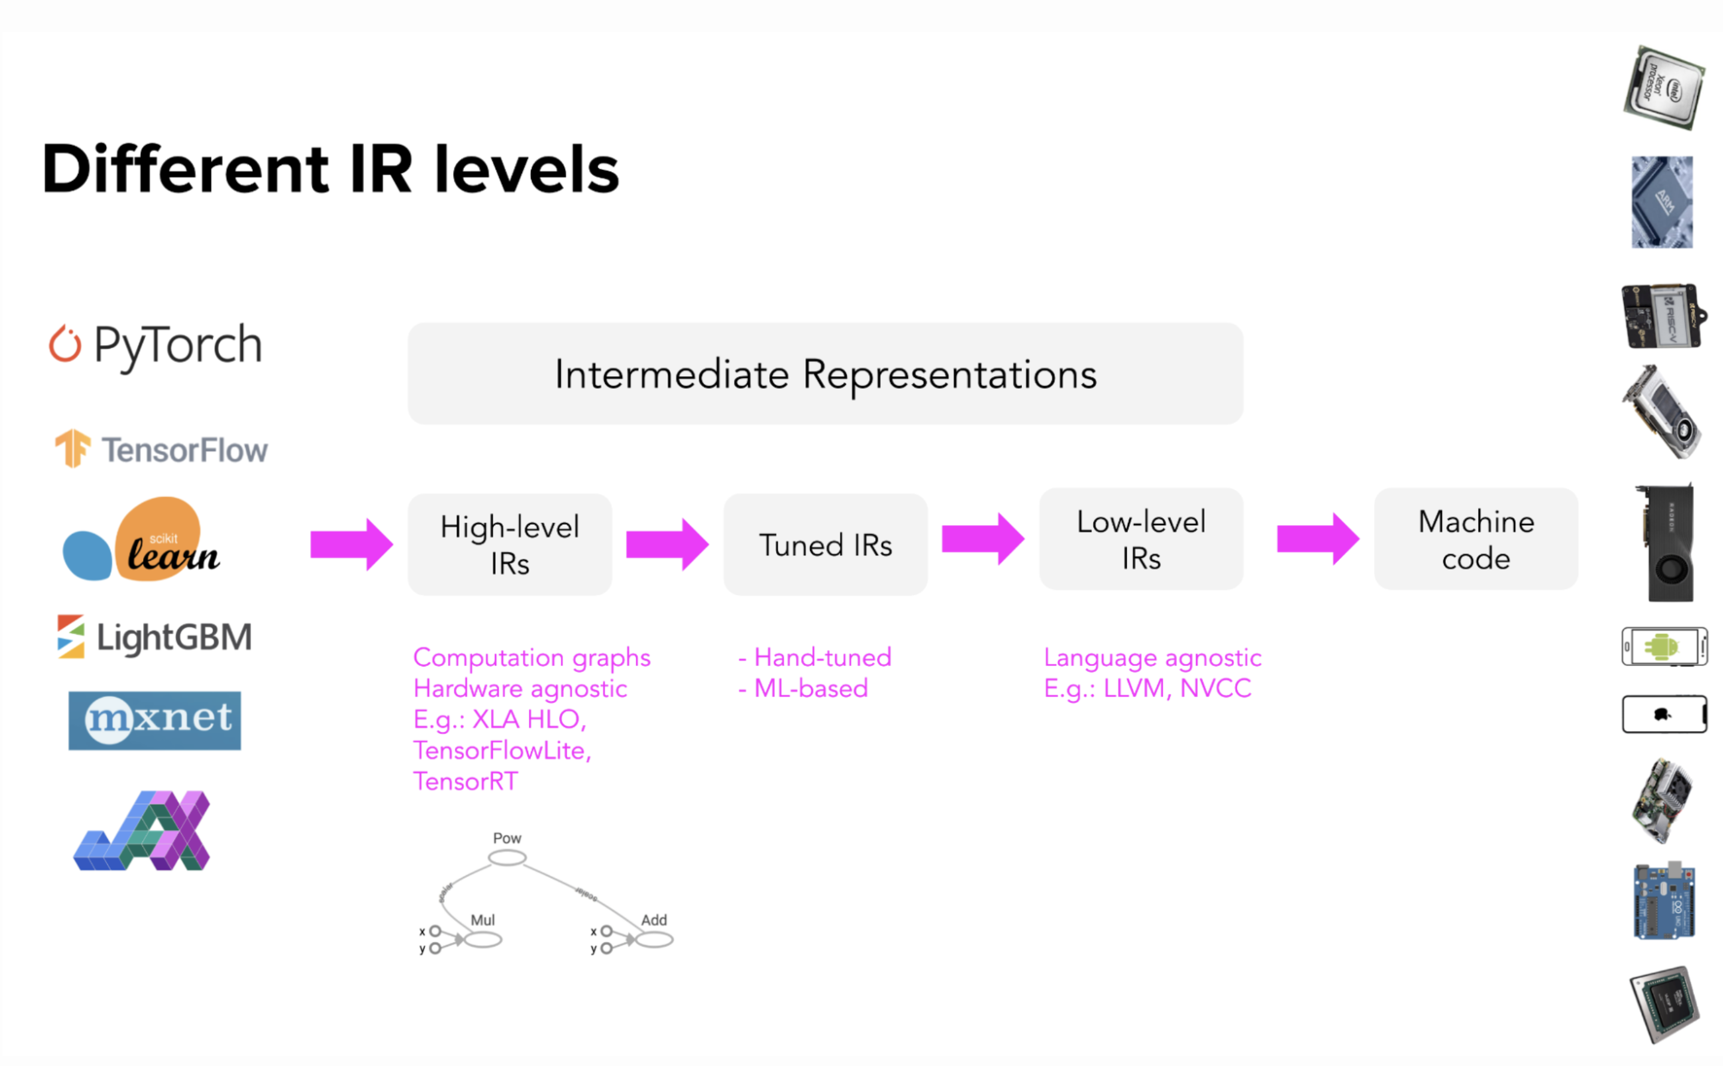
TVM compiler flow

Slide 6
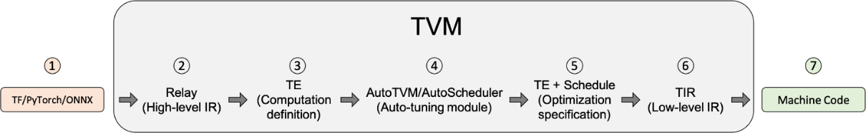
TVM compiler flow
1. Input model from ONNX, Pytorch, Tensorflow,...

Slide 7
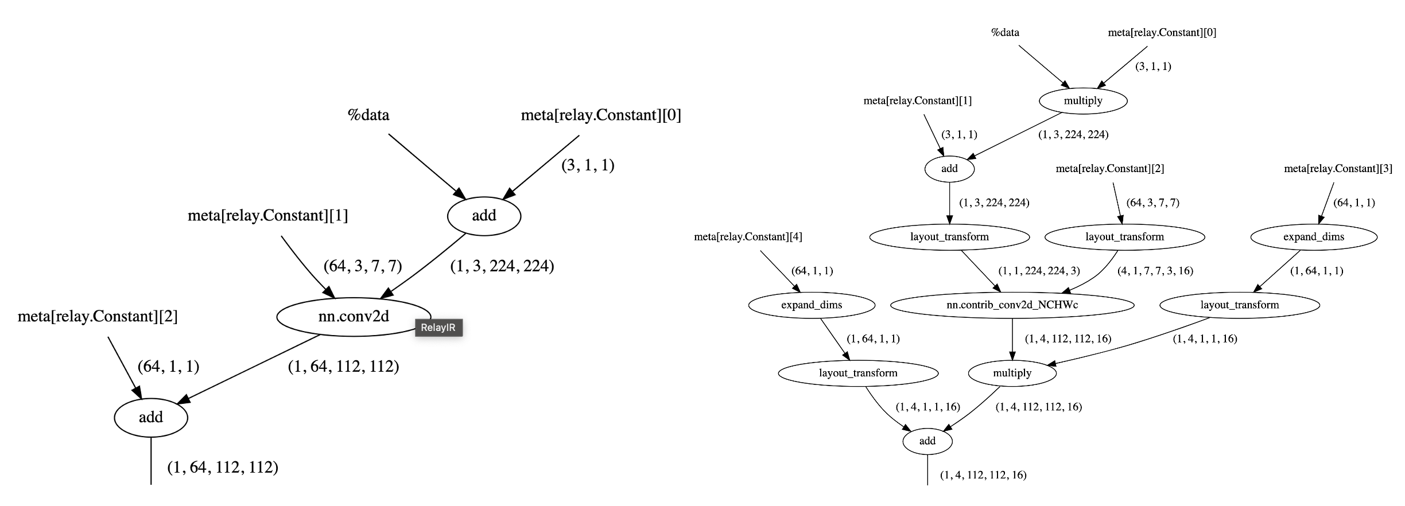
TVM compiler flow
2. Parse model to Relay, a hybrid kind of Directed Acyclic Graph and Let-binding Graph
and apply Relay transformations, such as Operator Fusion, Layout Transformation,...

Slide 8
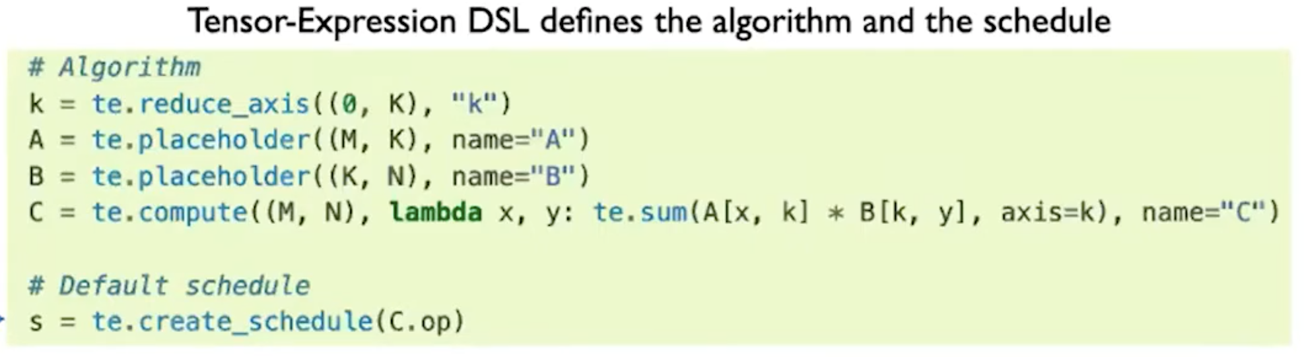
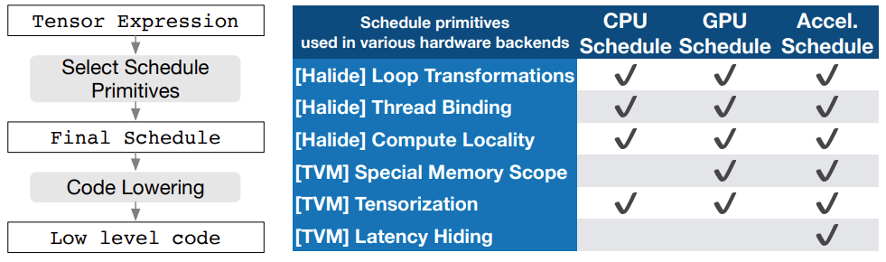
TVM compiler flow
3. Model is lowered to TE (Tensor Expression) by FuseOps pass. TE is a domain-specific language to describe tensor computation.
TVM provides schedule primitives to implement low-level (hardware-aware) optimization.
schedule primitives is a set of transformations used to simplify and optimize tensor computation to hardware.

Slide 9
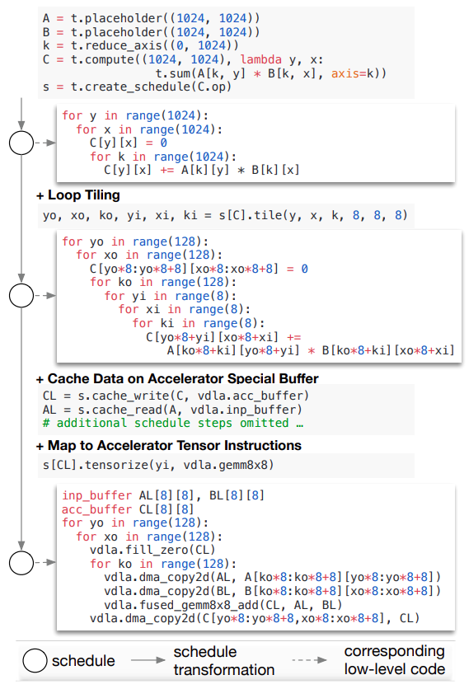
TVM compiler flow
3. Model is lowered to TE (Tensor Expression) by FuseOps pass. TE is a domain-specific language to describe tensor computation.
TVM provides schedule primitives to implement low-level (hardware-aware) optimization.
schedule primitives is a set of transformations used to simplify and optimize tensor computation to hardware.

Slide 10
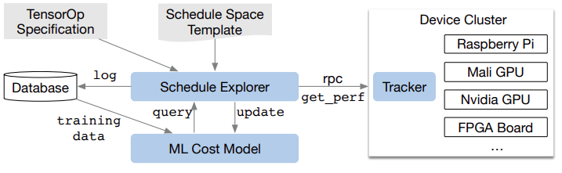
TVM compiler flow
4. Find the best way to deploy schedule primitives for tensor-expressed model to the target hardware.
Schedule Exporer examines the schedule space using pre-defined template or ML-cost model and chooses experiments to run on distributed device cluster via RPC.
Measurement data is collected during exploration.
Not require detailed hardware configuration.

Slide 11
TVM compiler flow
4. Find the best way to deploy schedule primitives for tensor-expressed model to the target hardware.
AutoTVM
Find the best schedule-specific parameters which are predefined on template (written by user via TOPI).
To write template, require sophisticated knowledge on hardware architecture.

Slide 12
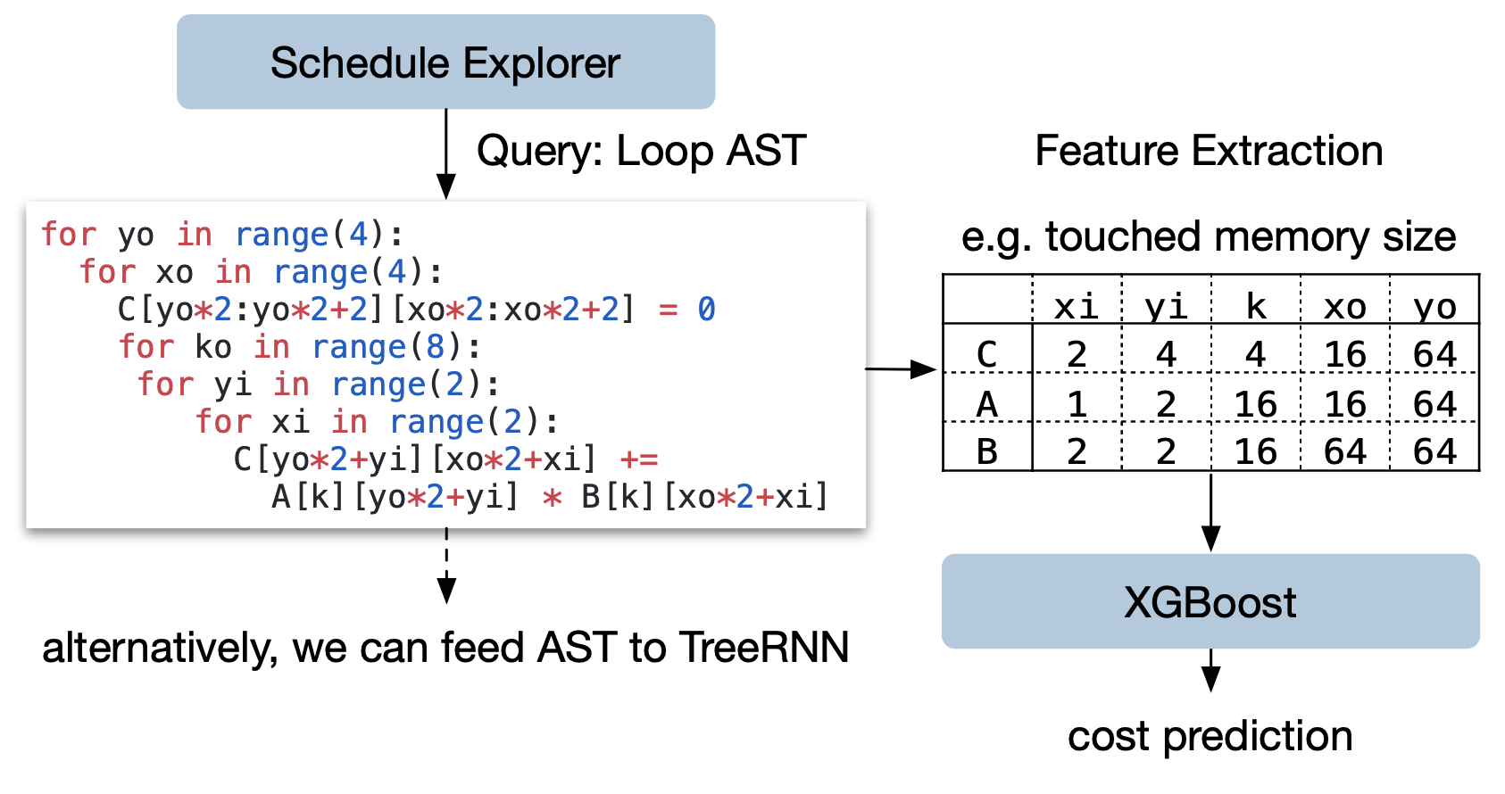
TVM compiler flow
4. Find the best way to deploy schedule primitives for tensor-expressed model to the target hardware.
AutoScheduler
Use Gradient-Boosting as ML-cost model
predicts running time on hardware backend
trained by real measurement data
inference time = 1000x faster than real measurement

Slide 13
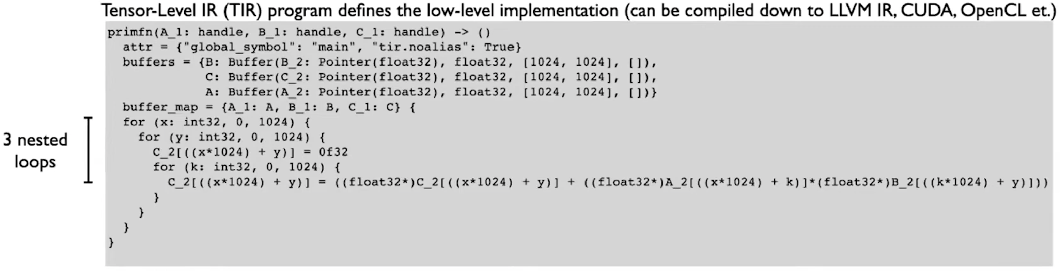
TVM compiler flow
5. Computation graph of model after optimization is saved to “.json” file.
Lower to TIR (Tensor Intermediate Representation) and apply low-level optimization such as access index simplification & dead code elimination

Slide 14
TVM compiler flow
6. Compile TIR to hardware, TVM supports:
LLVM
NVCC (NVIDIA’s CUDA Compiler), OpenCL
Customed compiler (via TVM BYOC (Bring Your Own Codegen))

Slide 15
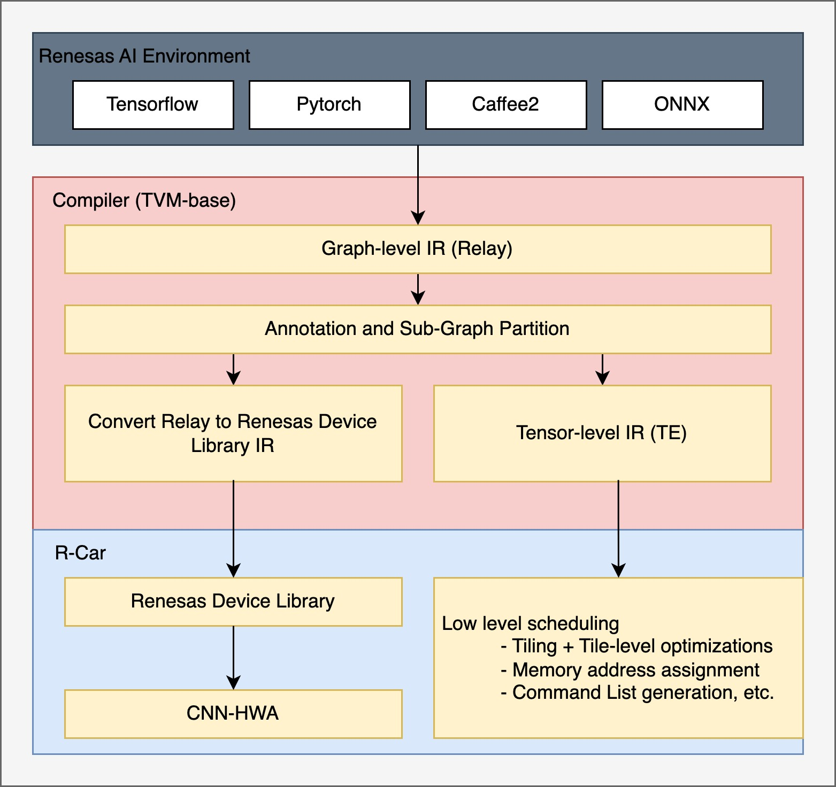
Case study: TVM BYOC on Renesas Rcar V4H
V4H BYOC flow
Integrate Renesas Device Library (RDL) as the backend module (in the traditional function-at-a-time style).
RDL is, which is our target specific compiler for R-Car V4H, and is responsible for mapping tensor operations to H/W and generating Command List (CL)s for CNN-HWA.
Some of the optimizations applied in RDL are
Optimal spatial and channel tiling
Tunneling: "vertical" execution of tiled layers with its intermediate results in SRAM.
CNN-HWA
CNN-HWA is capable of executing a convolution operation of a specific size.
A convolution is tiled to fit the computation unit and its partial sums are accumulated in SRAM
6x performance than on ARM Cortex A76 with minimum acc. drop

Slide 16
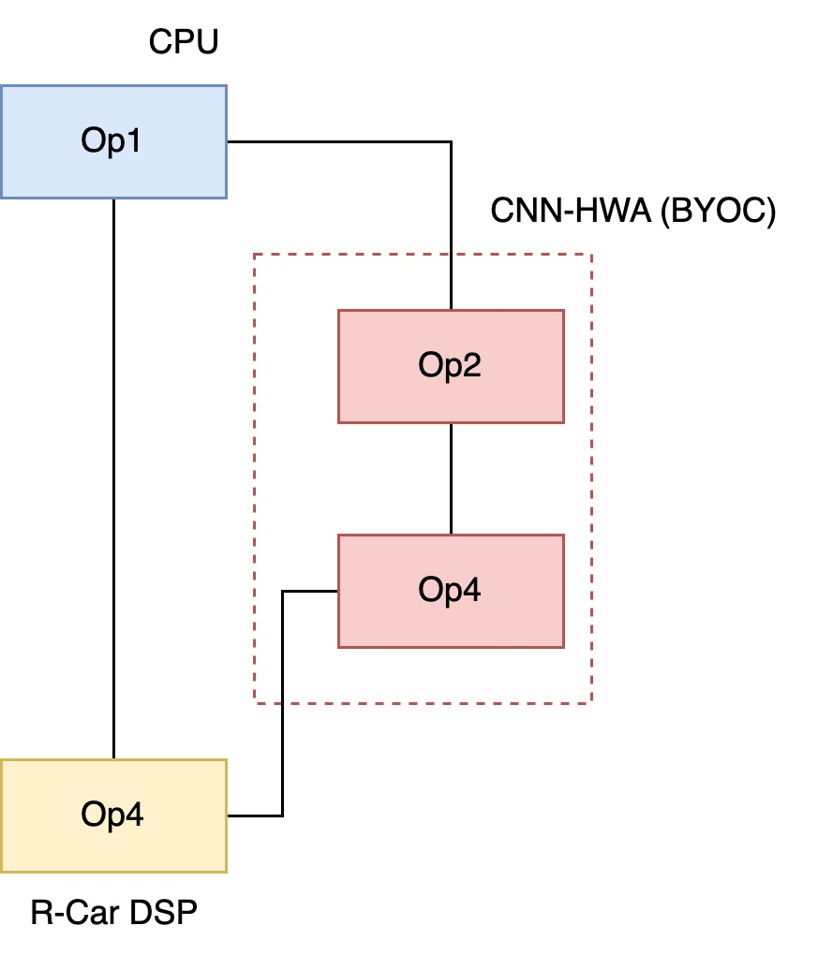
Case study: TVM BYOC + Auto-scheduling
R-Car DSP integration
Generate C/C++ code for the DSP compiler
Apply auto-tuning (e.g. MetaSchedule, Ansor)
Heterogeneous execution DSP + CNN-HWA
CNN-HWA TIR level integration
Finer control over H/W mapping via TIR/TE scheduling primitives to easily and flexibly apply lower level optimizations
Apply auto-tuning to provide relatively good performance without requiring manual scheduling and target specific heuristic algorithms
Cooperative execution between CPU, DSP and CNN-HWA

Slide 17
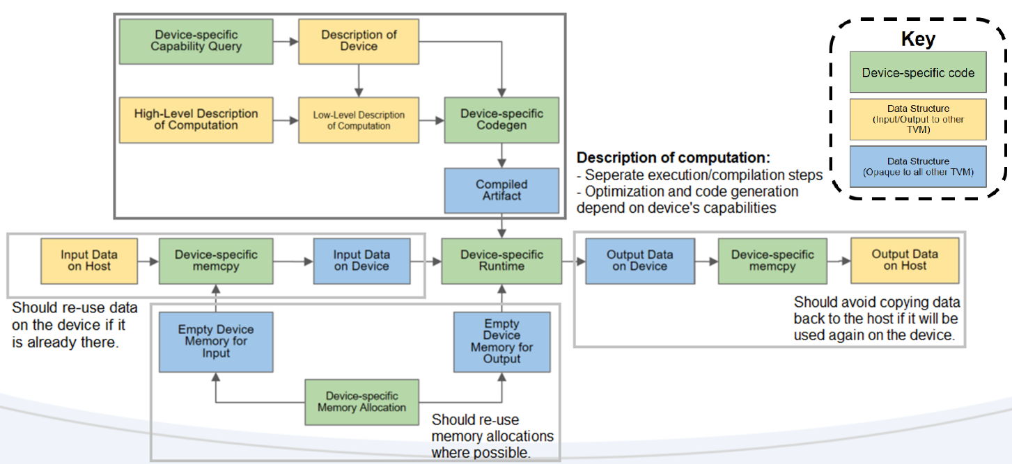
Device/Target Interactions

Slide 18
Applying TVM to gencode C for ASIP
Known approaches to add ASIP hardware to TVM:
1. TVM BYOC:
A bridge from hardware provider to user.
Hardware backend provider can easily implement your own codegen and register it as a Relay backend compiler to support your hardware device/library.
=> CHALLENGING! Need someone who has backend and codegen background!
2. Generate code C for ASIP
Can generate from .tflte and .onnx model to pure code C.
TVM Runtime (no external libraries are used) checks generated code C by random input tensor. => Generated code are compatible with LLVM front-end. => Generated code can not use custom variables or functions of ASIP.

